Slide 1




Week-6 (Discussion)
29th Aug, 2025
Computer Vision
Prof. Jayanta Mukhopadhyay
Professor
Computer Science and Engineering Department
IIT Kharagpur
Ayan Paul
PMRF Research Scholar
IIT Kharagpur

Slide 2
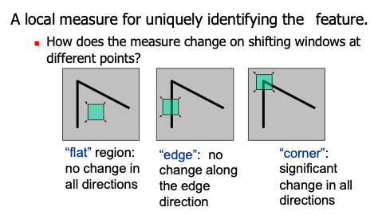
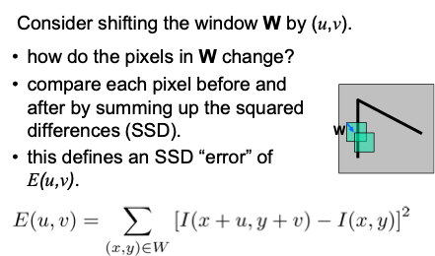
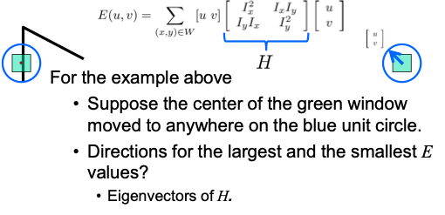
Feature Detection
Feature Detection: To find distinctive and repeatable points/regions in an image that can be reliably identified across different images (even if the object is rotated, scaled, or illuminated differently). These points are called keypoints, interest points, or features.
Desirable properties of detected features:
Repeatability: Detected in multiple views of the same scene.
Distinctiveness: Features look different from each other.
Invariance: Robust to scale, rotation, illumination, and minor affine distortions.
Locality: Localized to avoid occlusion issues.

Slide 3
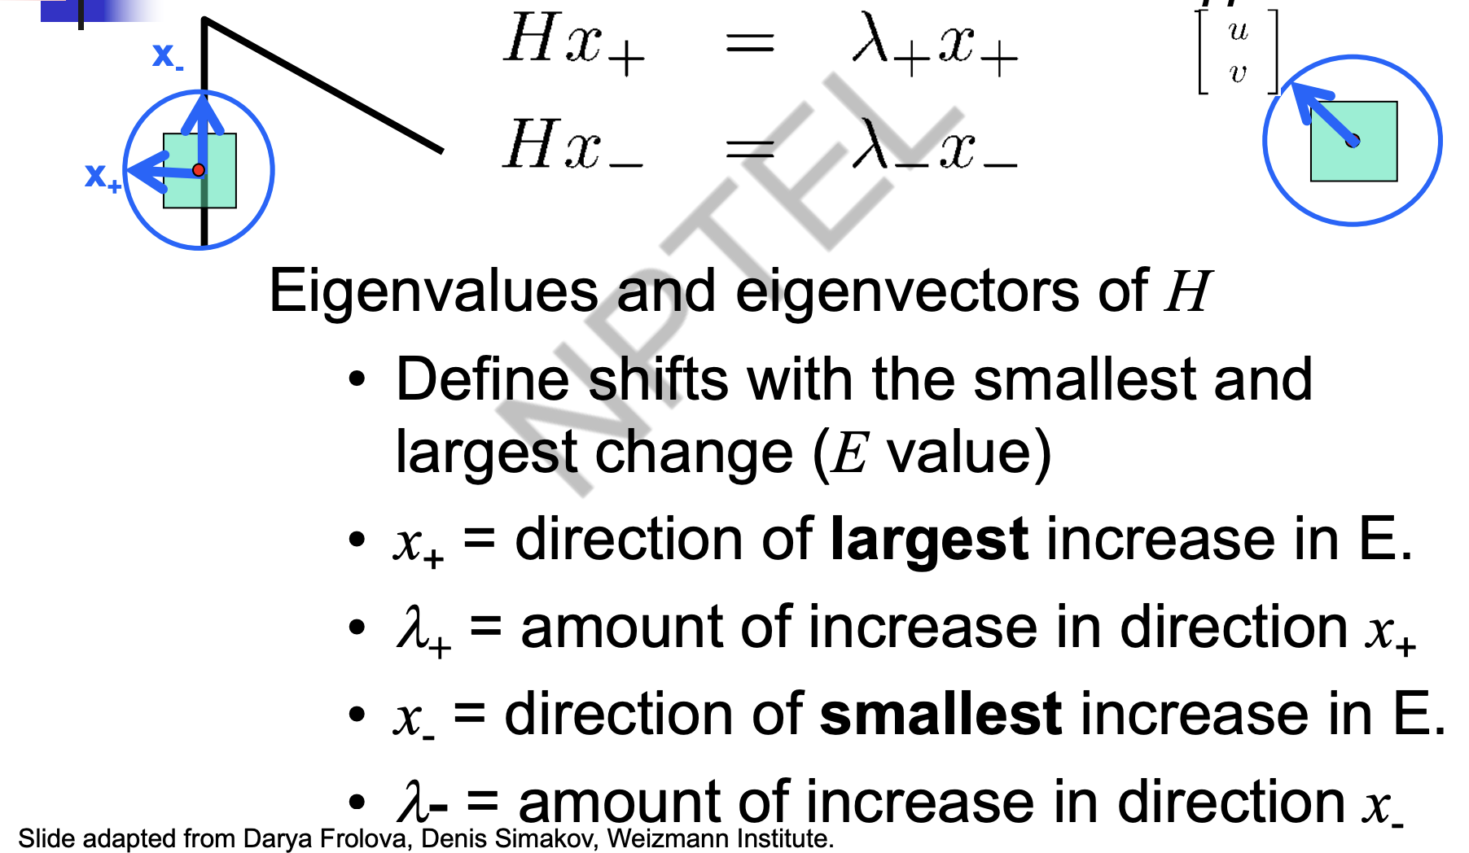
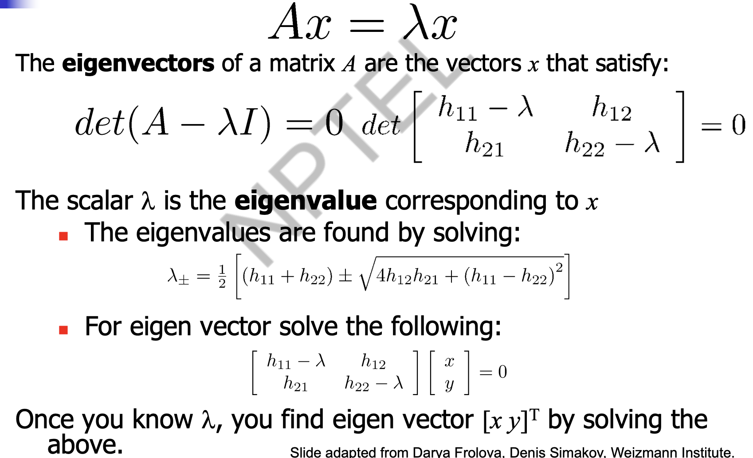
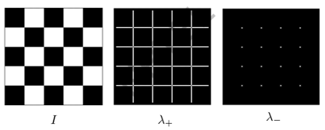
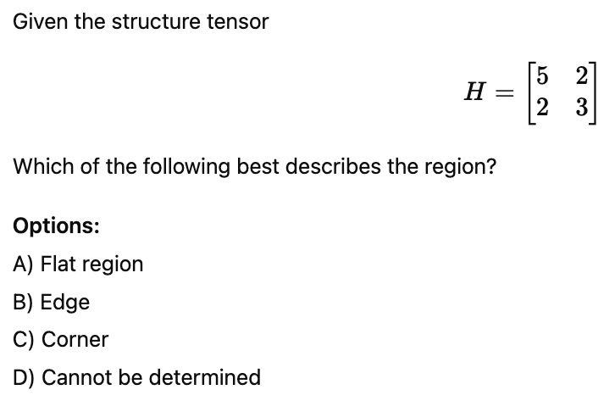
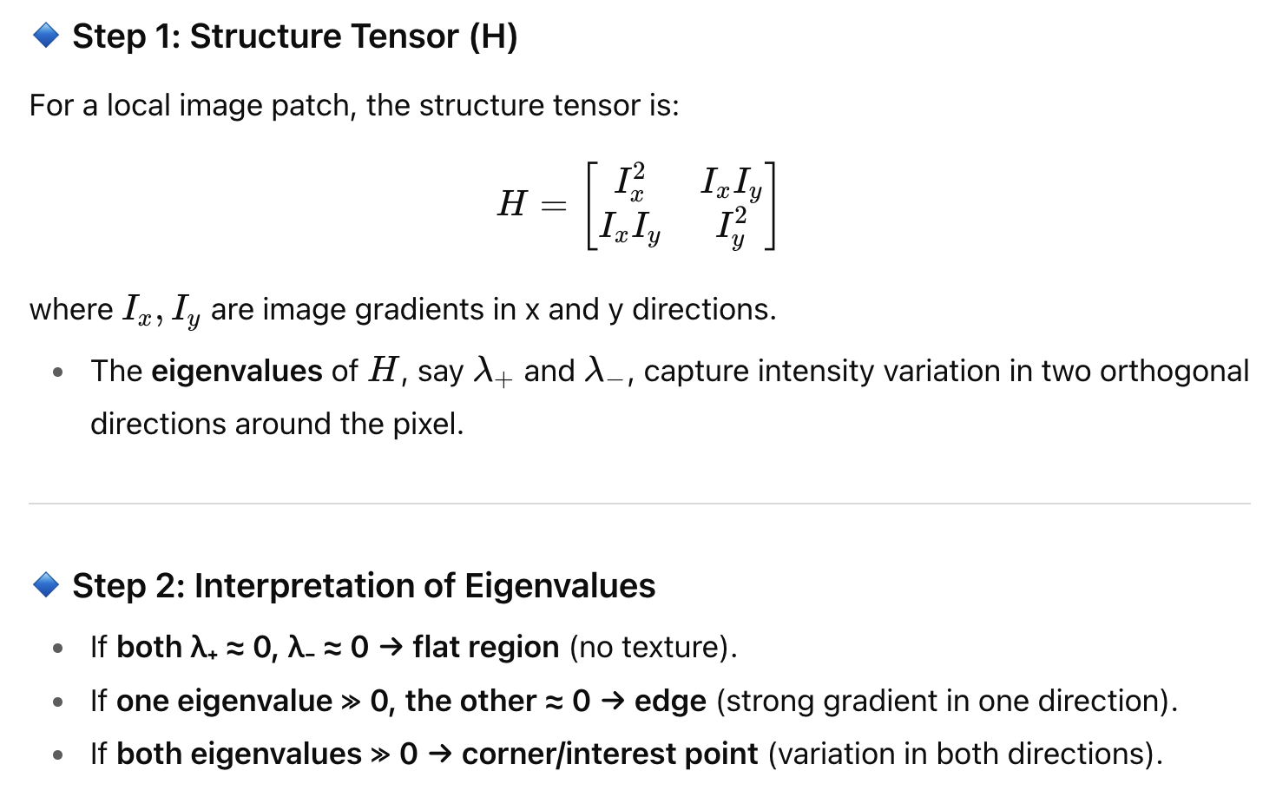
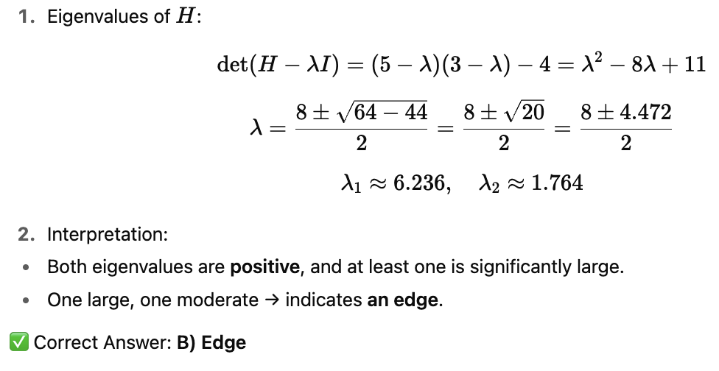
Quick eigenvalue/ eigenvector review
Exercise -1
Solution

Slide 4
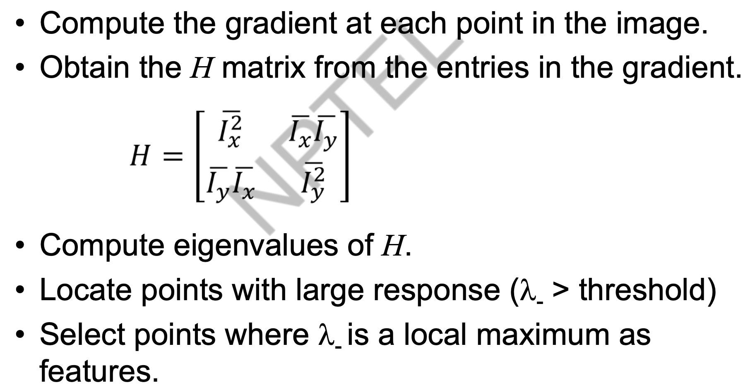
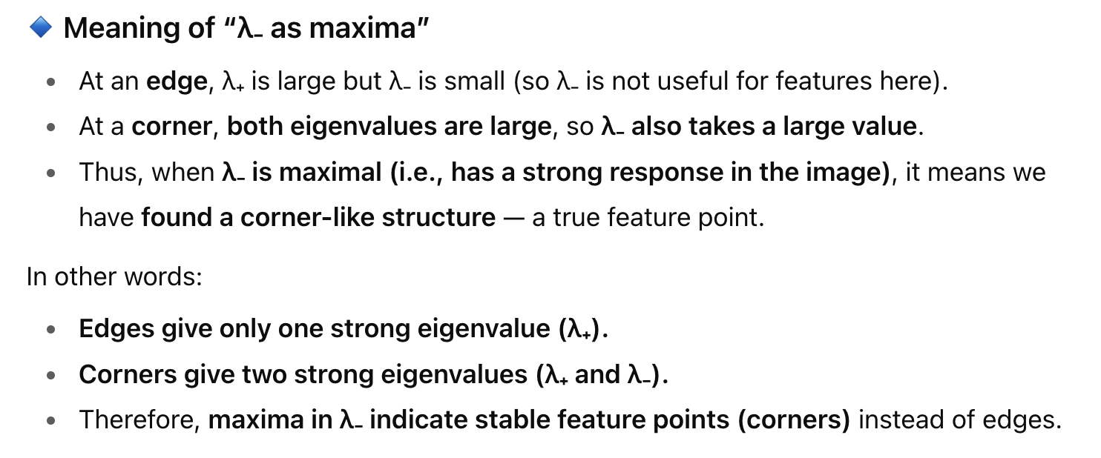
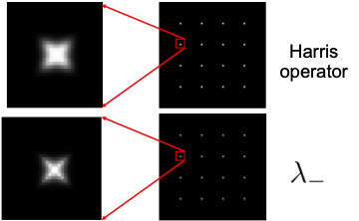
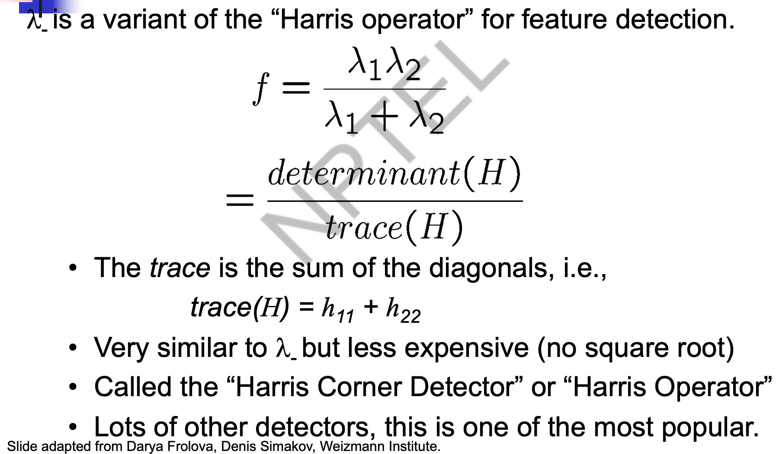
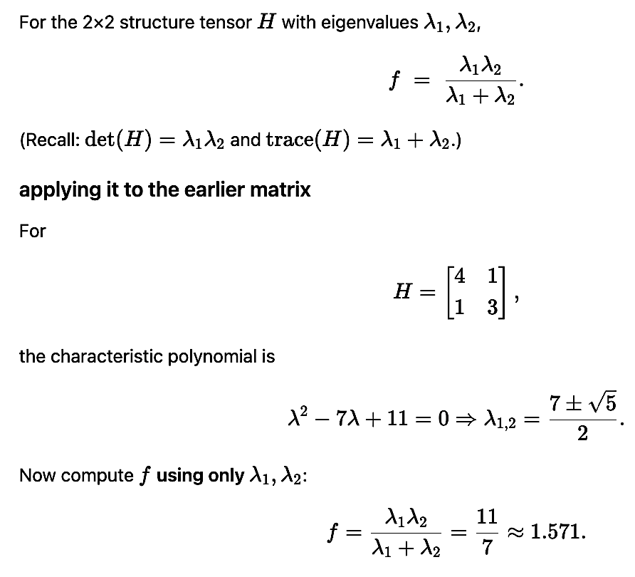
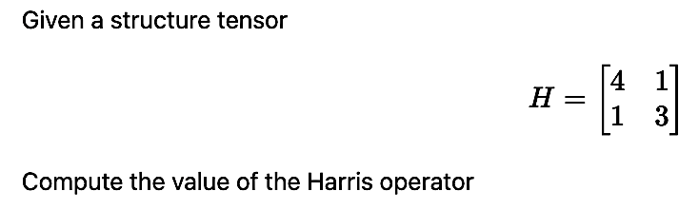
Feature detection: Algorithm
Local maximum: illustration
The Harris operator
Exercise -2
Solution

Slide 5
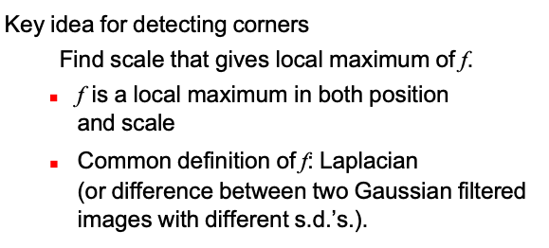
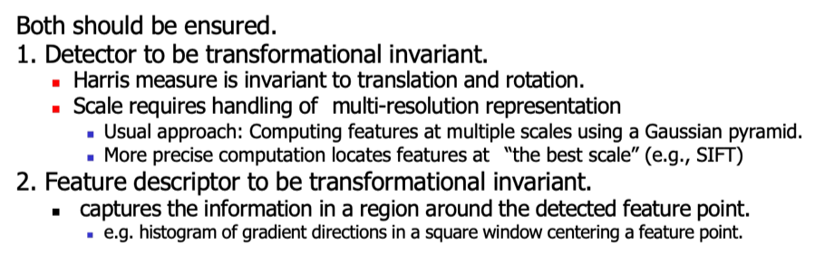
Feature Descriptor and Matching
Feature Matching: Feature matching is the process of finding corresponding features (keypoints) between two or more images. It uses:
Feature detection (find keypoints).
Feature description (encode keypoints into descriptors/ local statistics).
Matching (compare descriptors to find correspondences).
Feature Description: Represent the local neighborhood around each detected feature in a way that is distinctive and invariant so that features from different images can be compared/matched.
Descriptor properties:
Rotation invariance: Same description if image is rotated.
Scale invariance: Works at different zoom levels.
Robustness: Works under noise, blur, illumination change.
Idea of Scale invariant detection
Detection and description: to be invariant

Slide 6
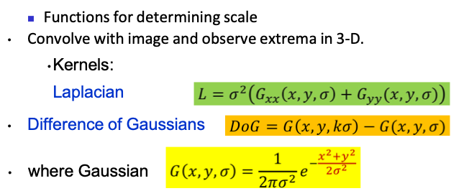
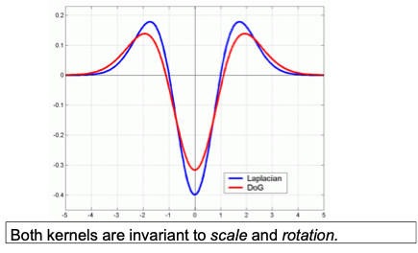
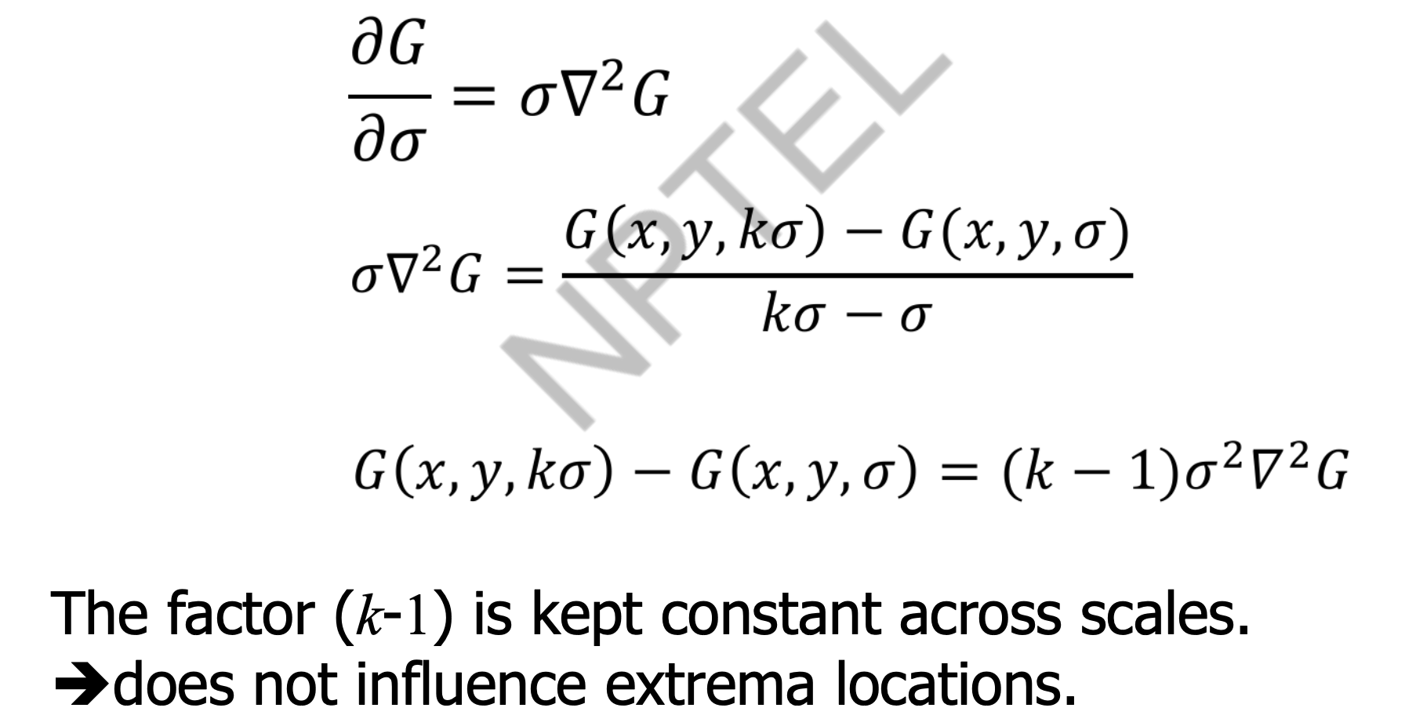
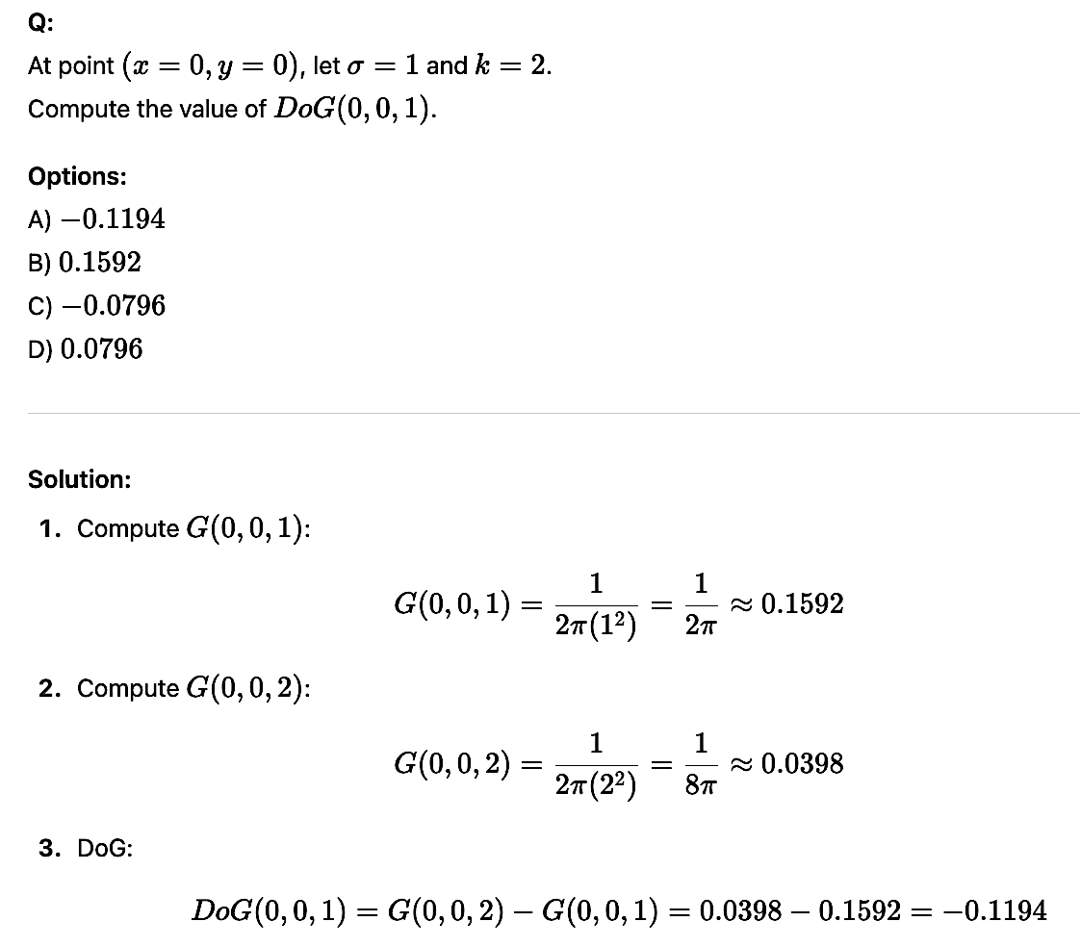
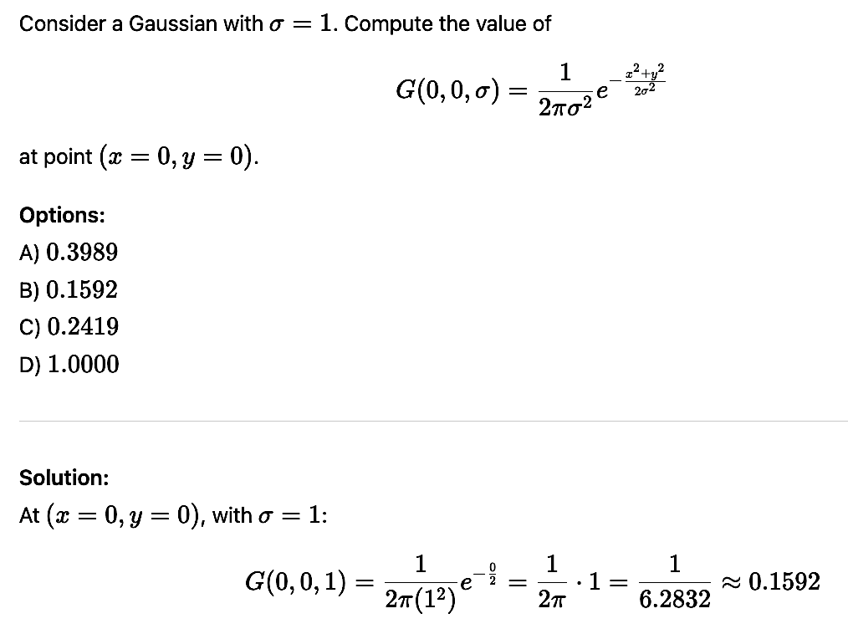
Scale invariant detection
Relationship between LoG and DoG operator
Exercise -4
Exercise -3
Solution
Solution

Slide 7
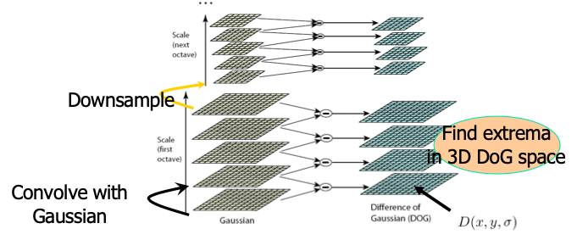
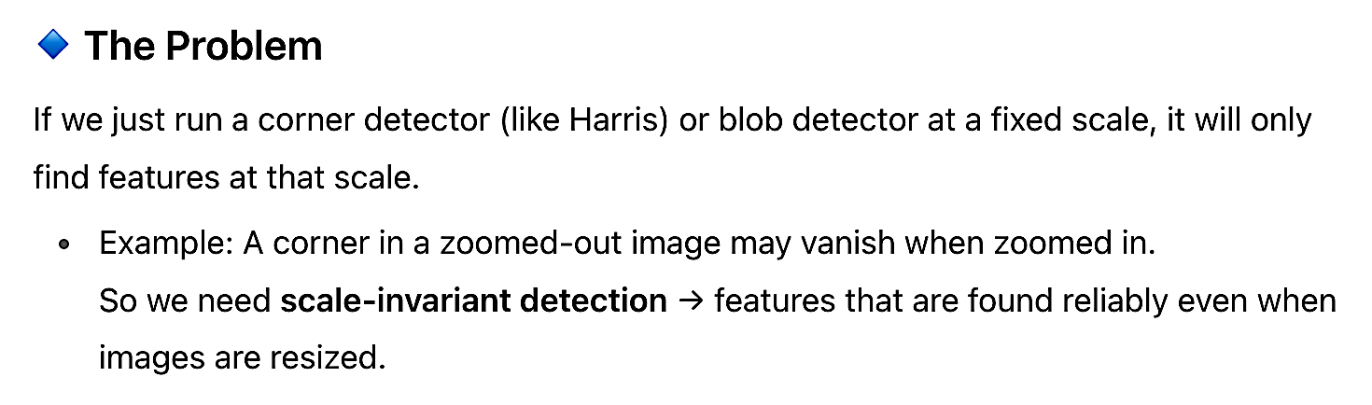
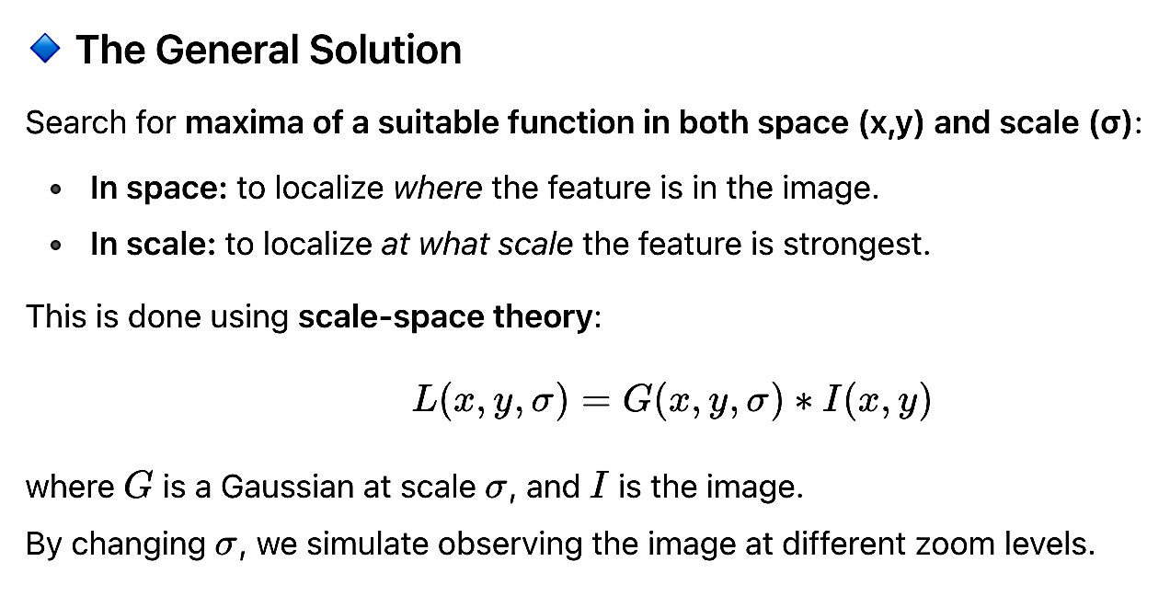
Finding Keypoints – Scale, Location
Scale Invariant Detectors Requirement

Slide 8
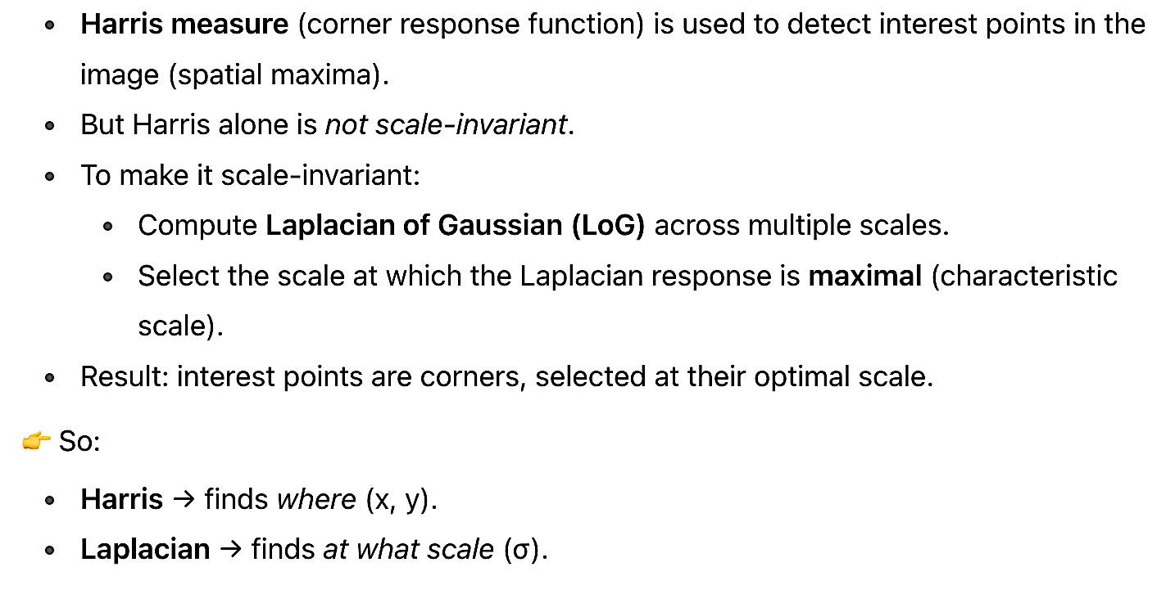
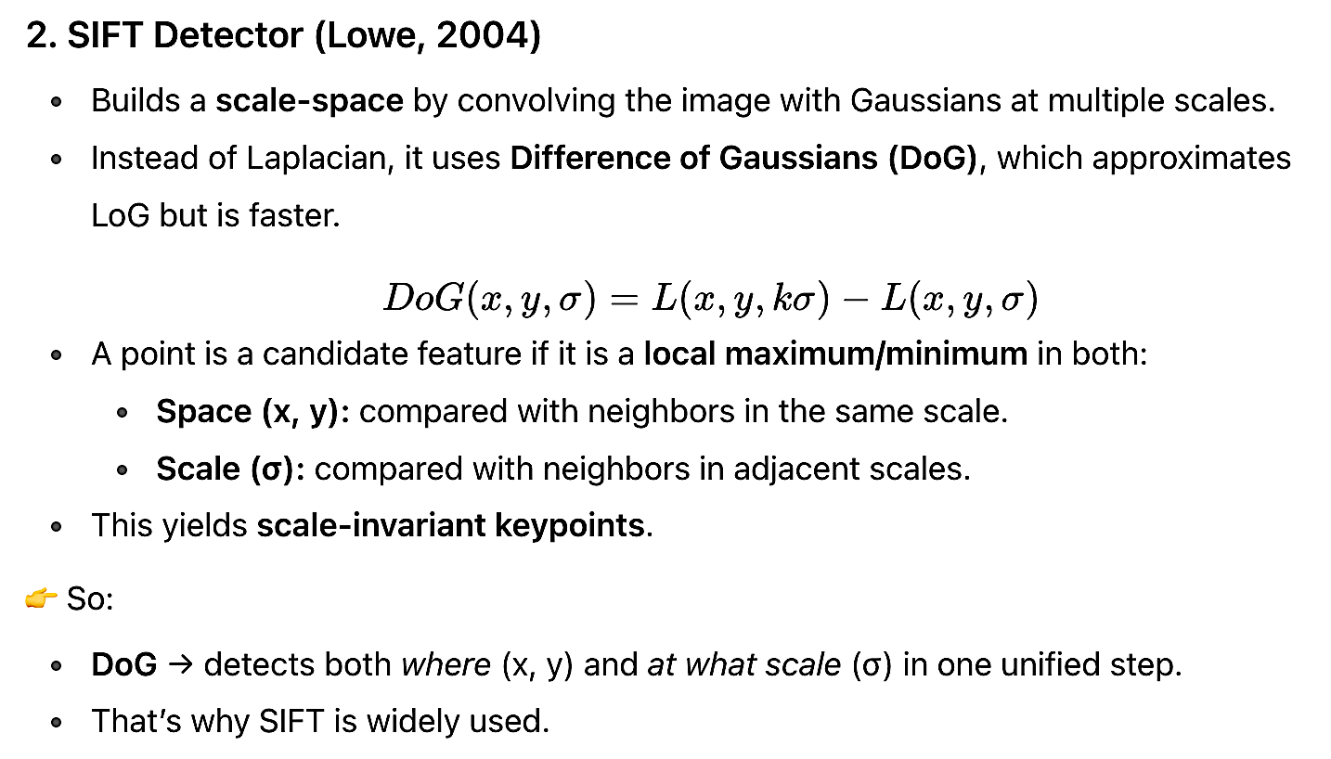
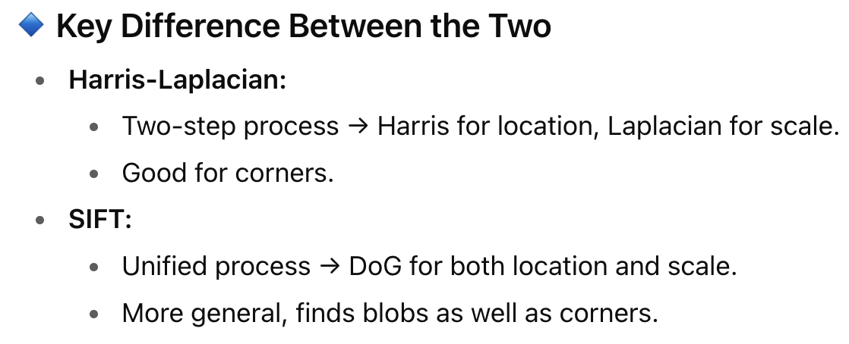
Harris-Laplacian (Mikolajczyk & Schmid)
Scale-Invariant Feature Transform (SIFT)

Slide 9
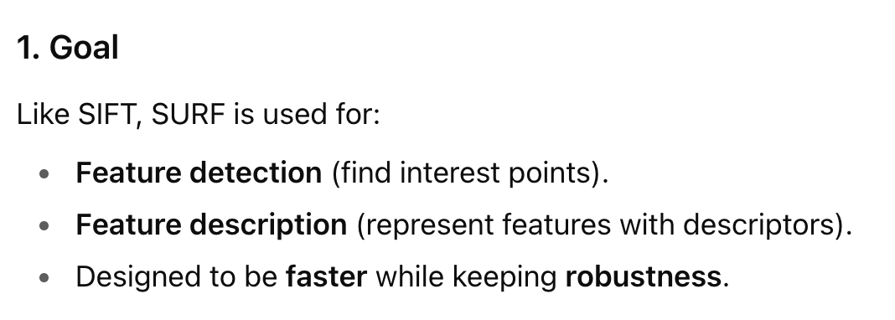
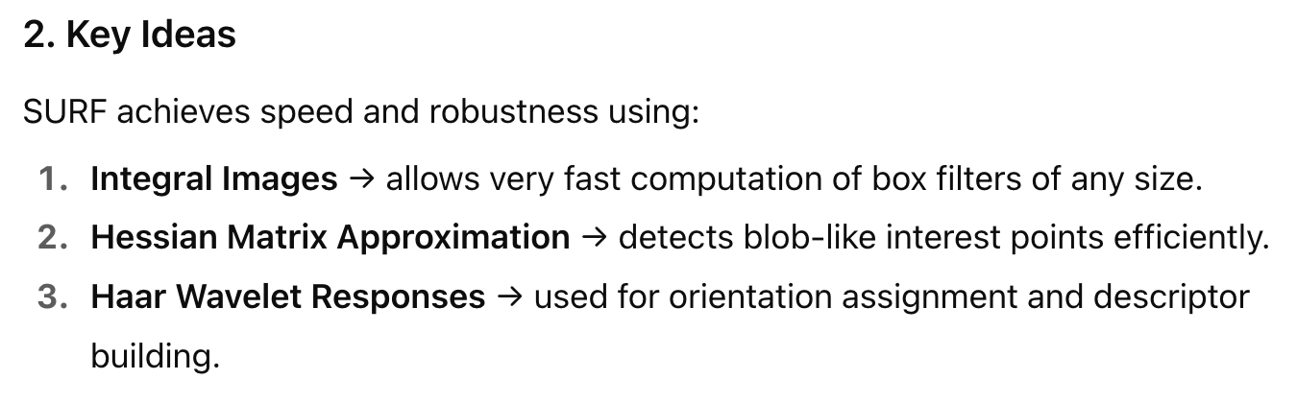
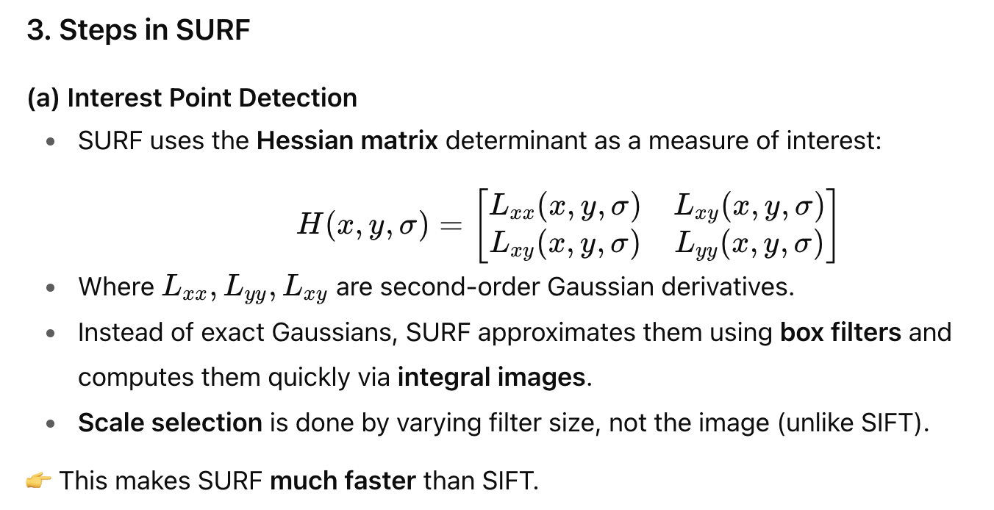
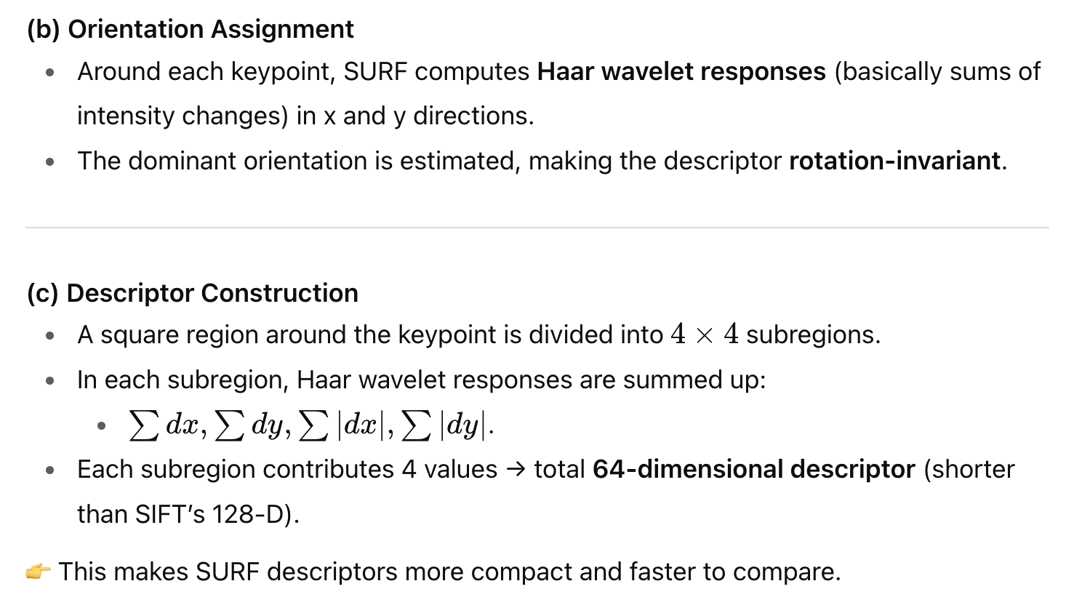
Speeded-Up Robust Features (SURF): Another descriptor

Slide 10
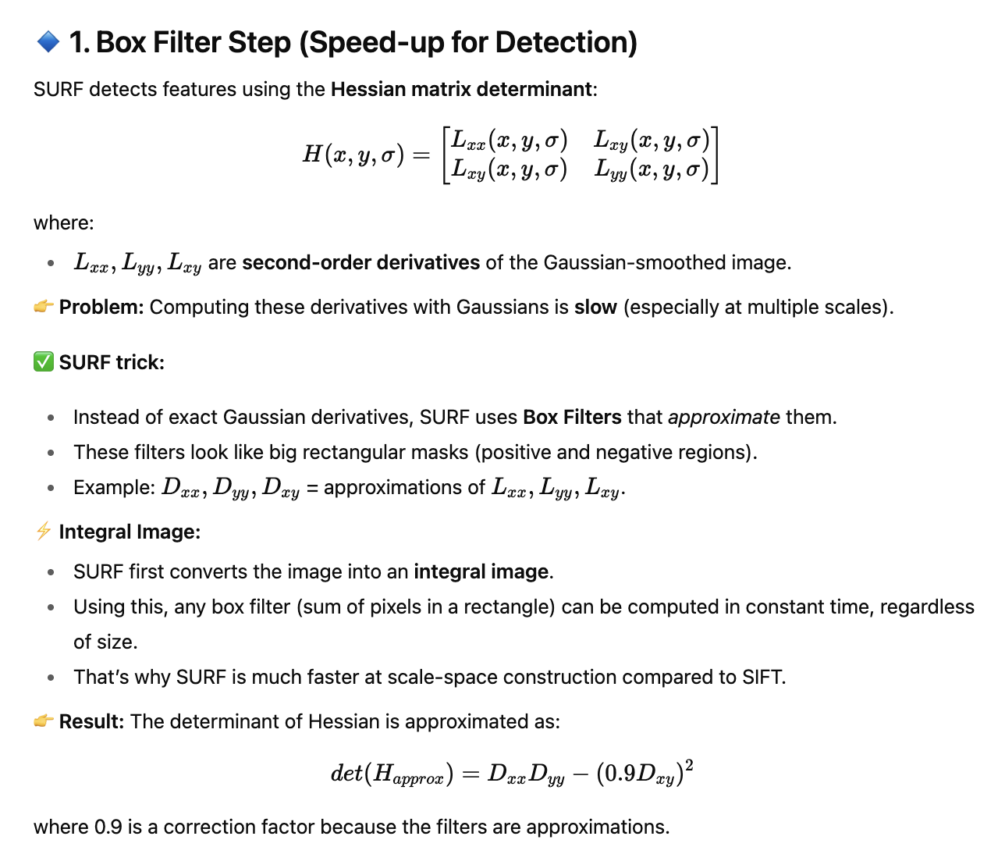
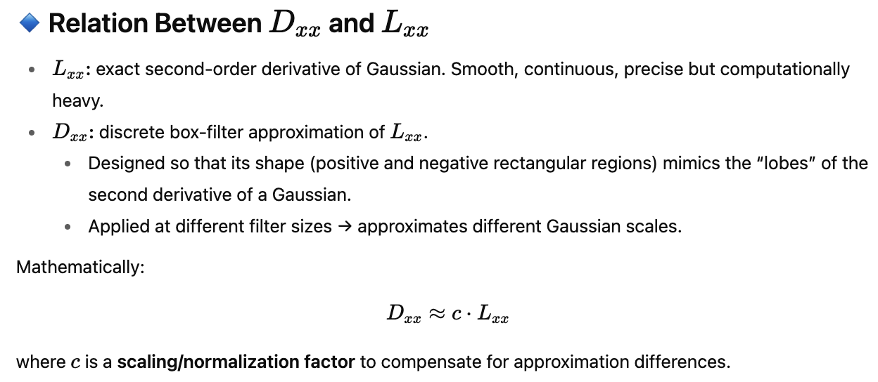
Core Features of SURF
Box Filter Step (Speed-up for Detection)

Slide 11
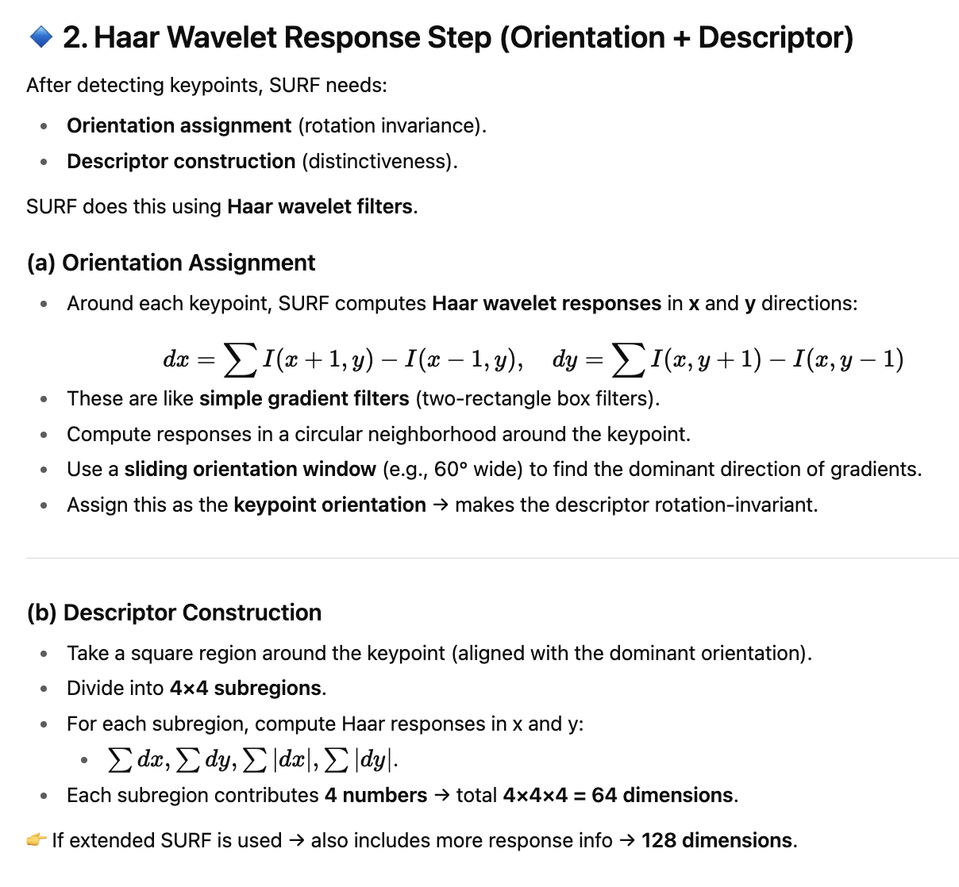
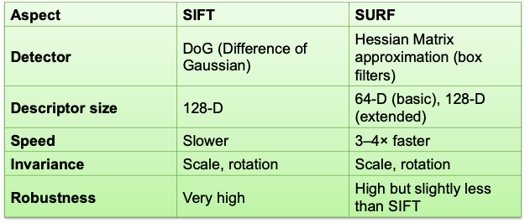
Haar Wavelet Response Step (Orientation + Descriptor)
SIFT vs SURF

Slide 12
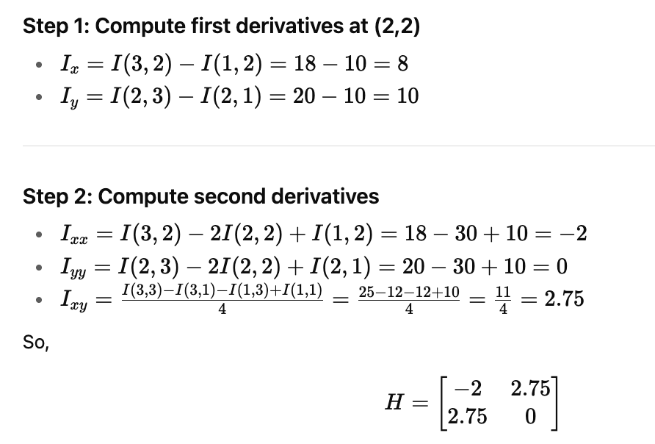
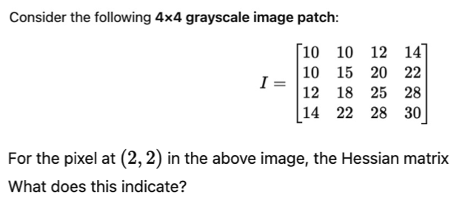
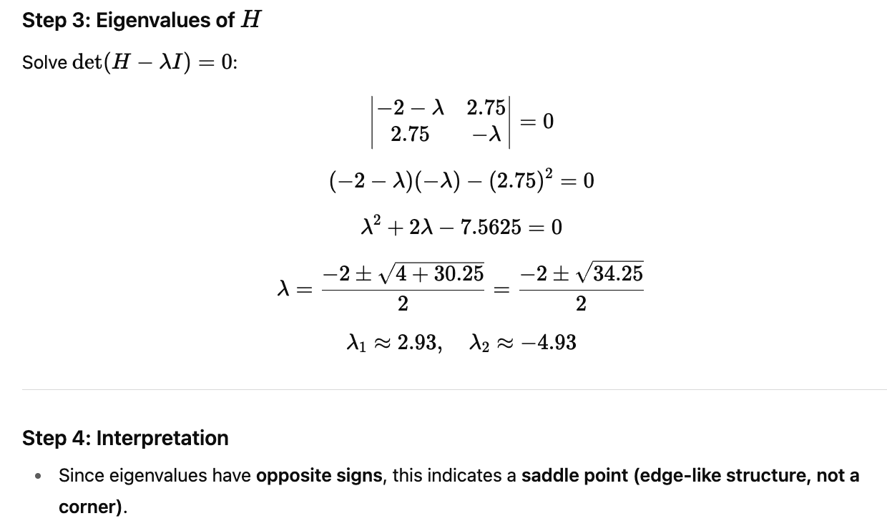
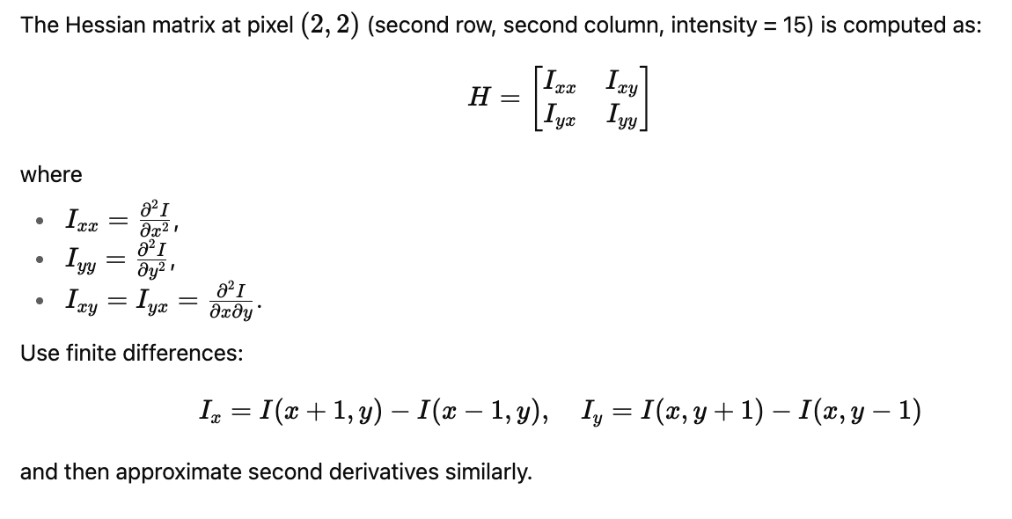
Exercise - 5
Solution

Slide 13
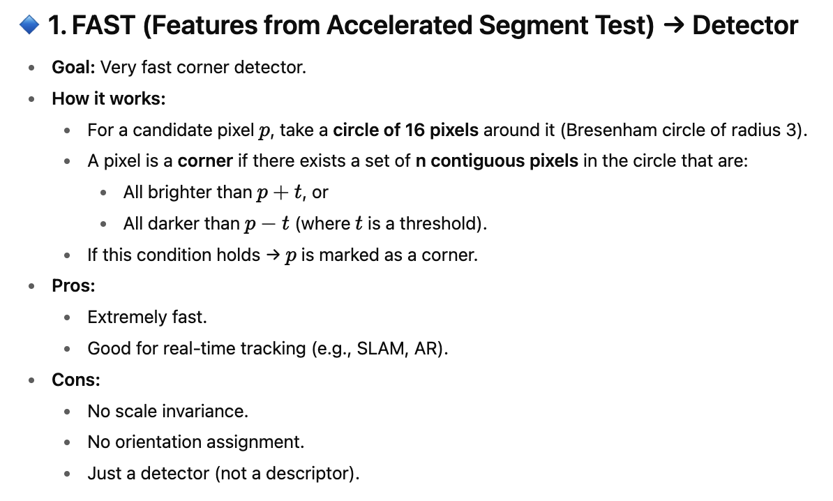
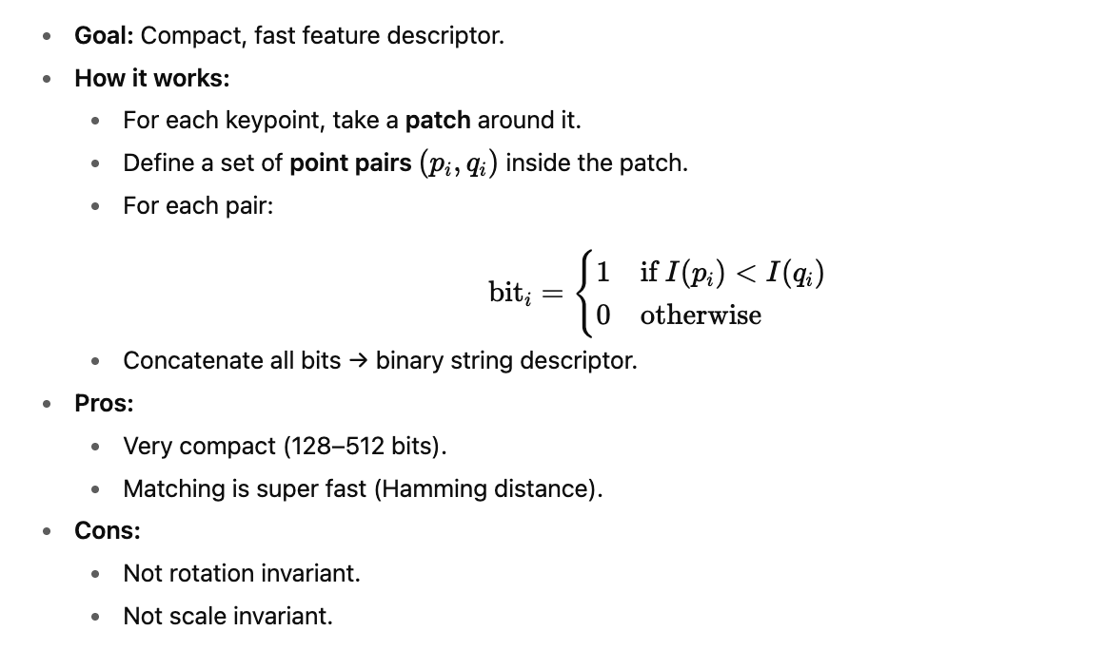
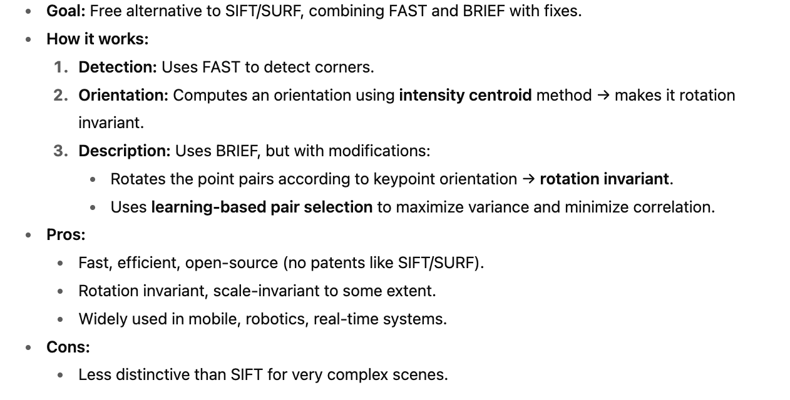
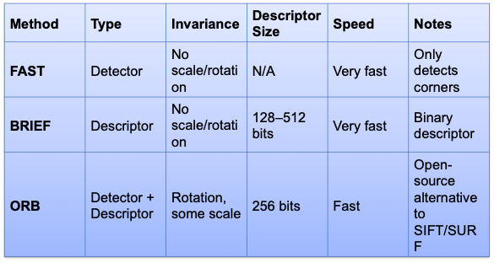
Other types of detectors and descriptors
FAST (Features from Accelerated Segment Test) → Detector
BRIEF (Binary Robust Independent Elementary Features) → Descriptor
ORB (Oriented FAST and Rotated BRIEF) → Detector + Descriptor

Slide 14
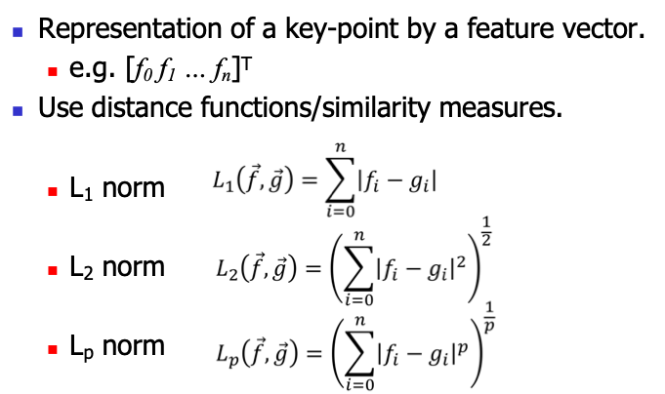
Matching of Feature Descriptors
Region Descriptors
When we have feature descriptors (from SIFT, SURF, ORB, etc.), we need to compare them between two images. The similarity (or dissimilarity) is measured using norms:
A region descriptor is a feature representation that describes a larger area (region) of an image instead of just a single keypoint.
A keypoint descriptor → describes a small neighborhood around a corner or blob (e.g., SIFT descriptor = 16×16 patch).
A region descriptor → encodes information from an entire region of interest (ROI), which may be irregularly shaped (e.g., a detected object, a segmented part of the image).
So:
Point descriptor = “local fingerprint” of a small patch.
Region descriptor = “signature” of a larger image region.
Types
Patch descriptors
Texture descriptors
Image / Sub-Image global descriptors

Slide 15
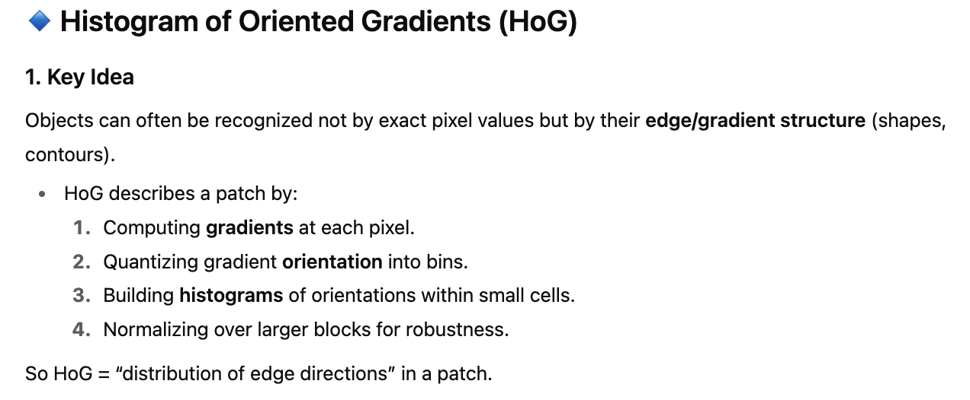
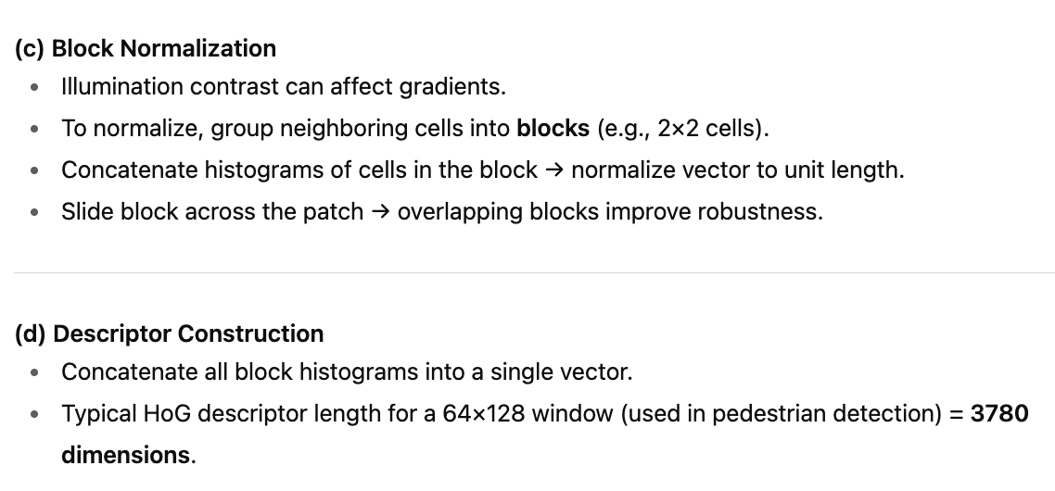
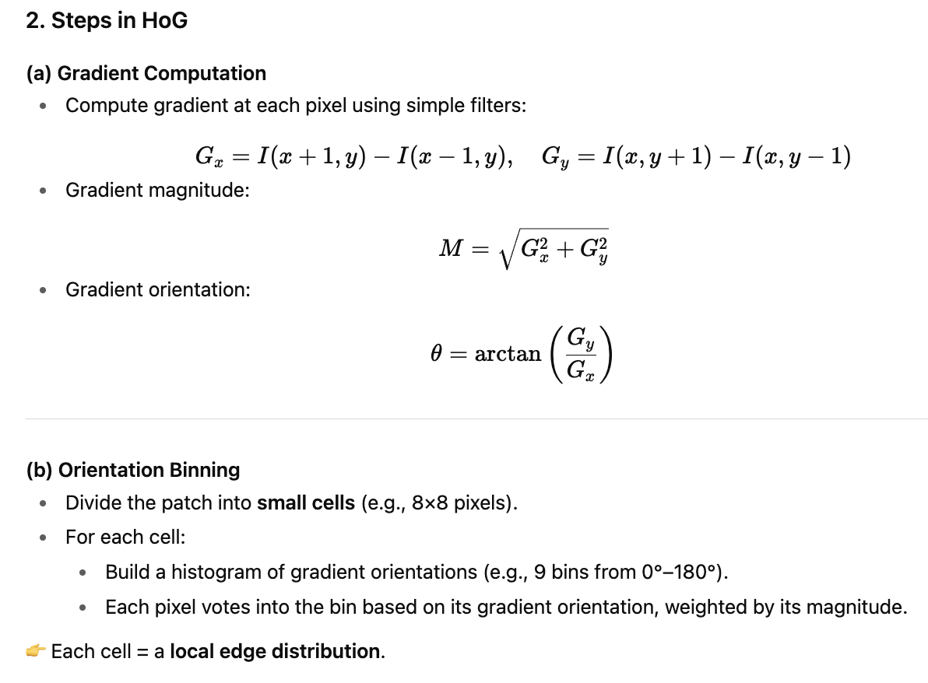
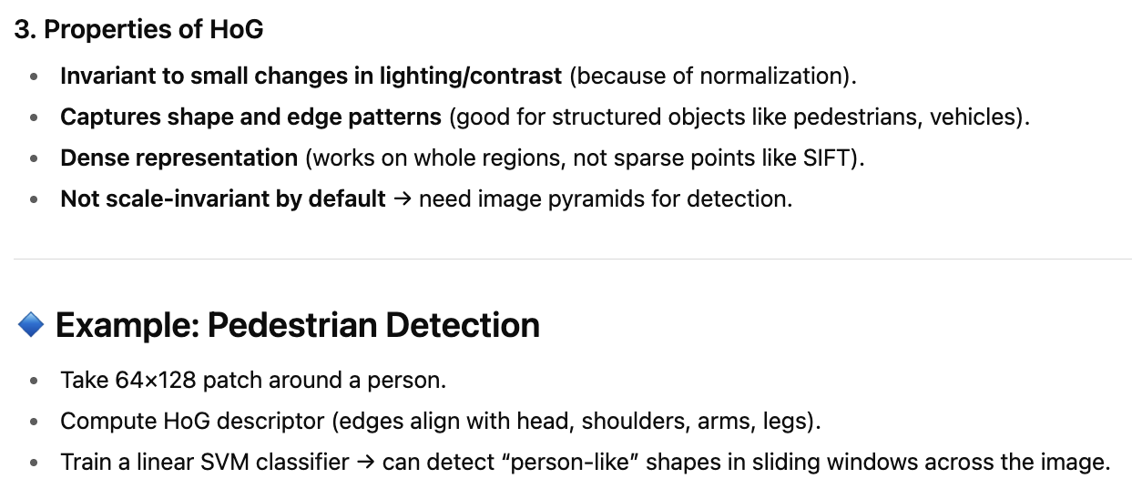
Patch Descriptor: Histogram of Gradients (HoG)
A patch descriptor encodes information about the appearance of a patch (a rectangular region of an image).

Slide 16
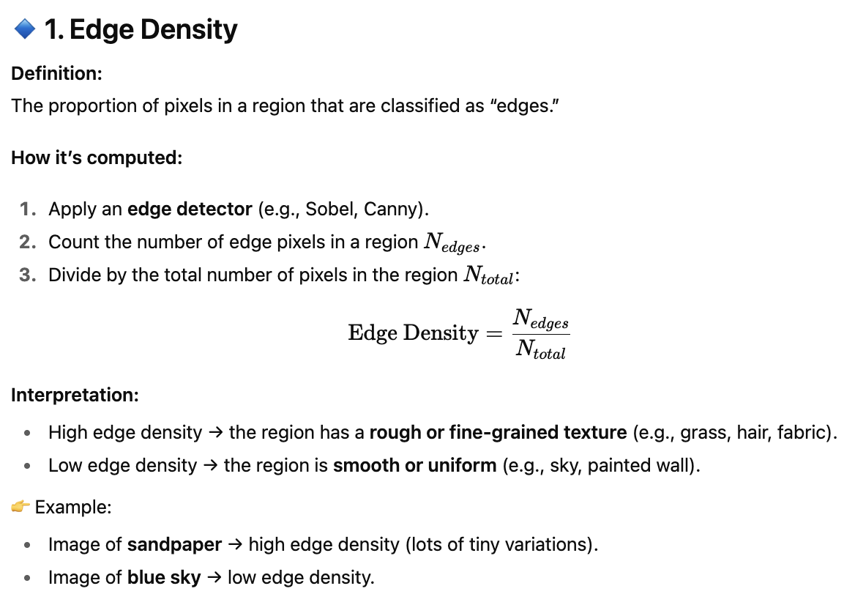



Texture descriptor
A texture descriptor is a numerical representation that captures the pattern of intensity variations in an image region.
Edge density and direction

Slide 17





Local Binary Pattern (LBP)
Exercise - 6
Solution

Slide 18







Co-occurrence Matrix

Slide 19



Exercise - 7
Solution

Slide 20



Slide 21






Texture Energy Features
Exercise - 8
Solution

Slide 22

Texture Descriptors Comparison
Use of texture descriptors
Detection of object patches represented by textured patterns.
Segmentation of images.
Classification / Matching
Generate a Library of labelled feature descriptors.
Detection of classes (class labels).
Matching to the nearest texture descriptor.

Slide 23


Image Descriptor
An image descriptor is a numerical representation of visual content in an image. A global image descriptor is a feature vector that represents the entire image as a whole, rather than individual parts or local regions.
Vector of Locally Aggregated Descriptors (VLAD)
Bag of Visual Words (BoVW)

Slide 24


Global Image Descriptors Comparison
Application of a global image descriptor

Slide 25
Topics on which Week 6 Assignment Questions are based
Feature Detection
Harris Operator
Feature Descriptor and Feature Matching
Harris-Laplacian and SIFT
FAST, BRIEF, ORB
Region Descriptor – Patch Descriptor, Texture Descriptor and Global Image Descriptor

Slide 26


QUESTION 1
Which of the following is/are true for SIFT and SURF?
a) Computation of scale space and histograms of gradient direction are approximated in SURF compared to SIFT.
b) Integral of images are used in SURF to speed up computation.
c) Small Gaussians used in SIFT are approximated by box filters in SURF.
d) Haar wavelet responses are used to accumulate the orientation in SIFT and SURF descriptors.
SOLUTION 1
.
CORRECT ANSWER 1
a), b), c)

Slide 27



QUESTION 2
SOLUTION 2
.
CORRECT ANSWER 2
b), d)

Slide 28


QUESTION 3
SOLUTION 3
CORRECT ANSWER 3
c)

Slide 29




QUESTION 4
SOLUTION 4
CORRECT ANSWER 4
b)

Slide 30



QUESTION 5
SOLUTION 5
CORRECT ANSWER 5
b)

Slide 31

QUESTION 6
If an octave in SIFT operator has 10 images, then the scale factor by which each image in
octave differs from the next image is
a) 1.080
b) 1.065
c) 1.071
d) 1.090
SOLUTION 6
CORRECT ANSWER 6
a)

Slide 32



QUESTION 7
SOLUTION 7
CORRECT ANSWER 7
c)

Slide 33


QUESTION 8
Which of the following is/are true for edge and corner detection?
a) A corner will have low maximal and minimal curvatures.
b) A corner will have high maximal and minimal curvatures.
c) An edge will have low maximal curvature, but very high minimal curvature.
d) An edge will have high maximal curvature, but very low minimal curvature.
SOLUTION 8
CORRECT ANSWER 8
b), d)

Slide 34


QUESTION 9
SOLUTION 9
CORRECT ANSWER 9
4.20

Slide 35


QUESTION 10
SOLUTION 10
CORRECT ANSWER 10
c)

